Slide 1
Euphemia Menjay
Fine Art Portfolio

Slide 2
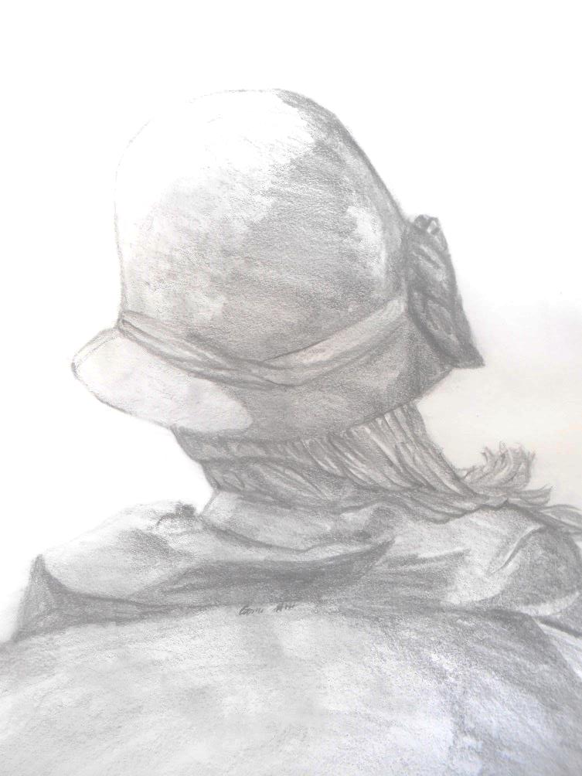
Figure Drawing Title: Thinking of… Medium: Graphite Pencil, Pastel Size:18’in x24’in Objective: Detailed and shadows Observational drawing

Slide 3
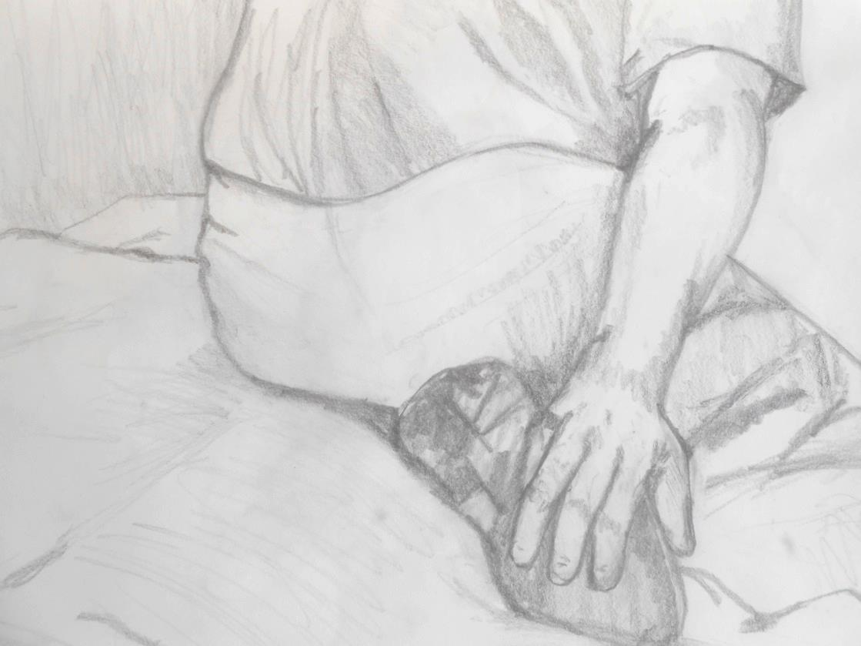
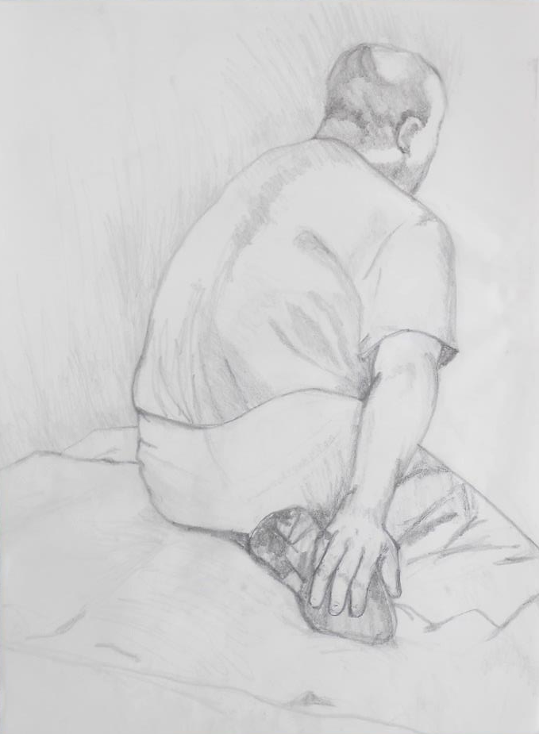
Figure Drawing Title: Yoga Stretching Medium: Graphite Pencil Size:18’in x24’in Objective: Detailed and shadows Observational drawing

Slide 4
Figure Drawing Title: Watching Television Medium: Graphite Pencil Size:18’in x24’in Objective: Draping and shading Observational drawing

Slide 5
Figure Drawing Title: lord-bordem Medium: Graphite Pencil Size:18’in x24’in Objective: Drawing in the technique and style of another artist Observational drawing

Slide 6
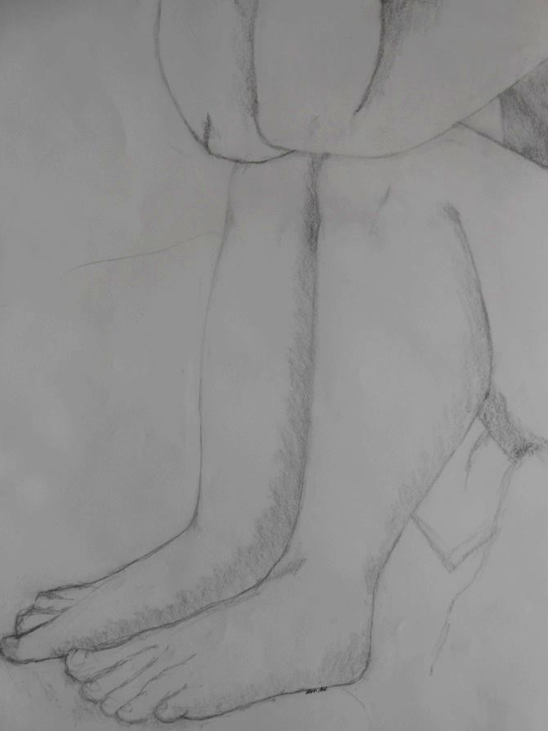
Figure Drawing Title: Stressing Medium: Graphite Pencil Size:18’in x24’in Objective: Foreshortening Observational drawing

Slide 7
Figure Drawing Title: Just Chill’in Medium: Graphite Pencil Size:18’in x24’in Objective: Foreshortening Observational drawing

Slide 8
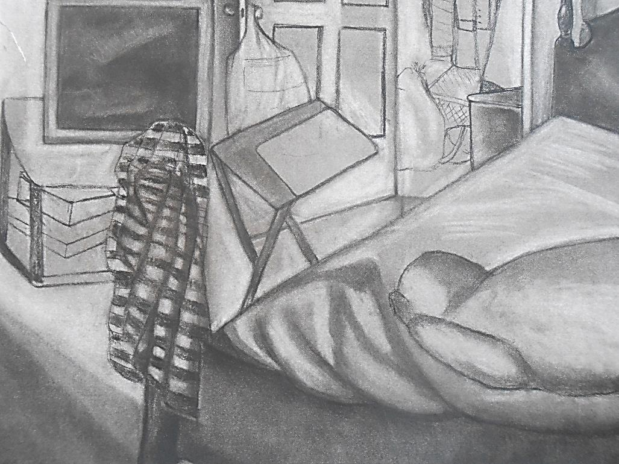
Drawing I Title: Cozy Room Medium: Charcoal Size:18’in x24’in Objective: Still Life, perspective drawing Observational drawing

Slide 9
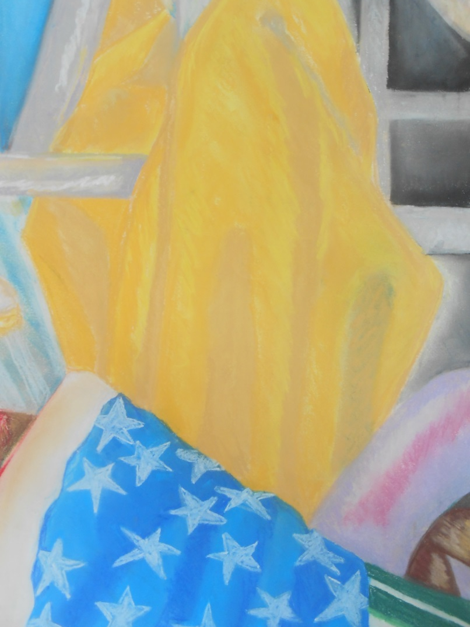
Drawing I Title: Made in America Medium: Color Pastels Size:18’in x24’in Objective: Still Life, Drawing with Pastels

Slide 10
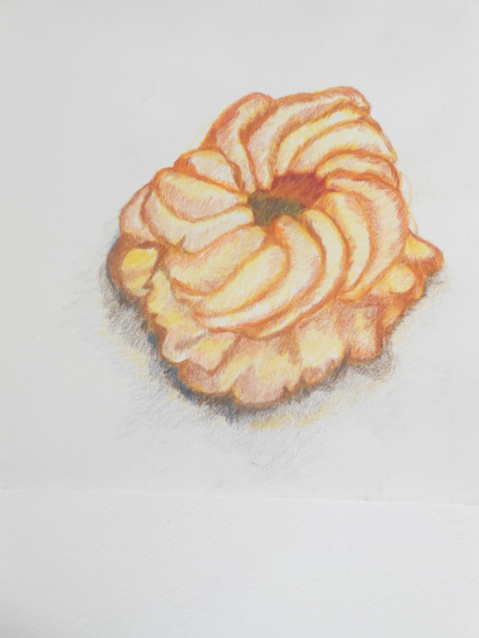
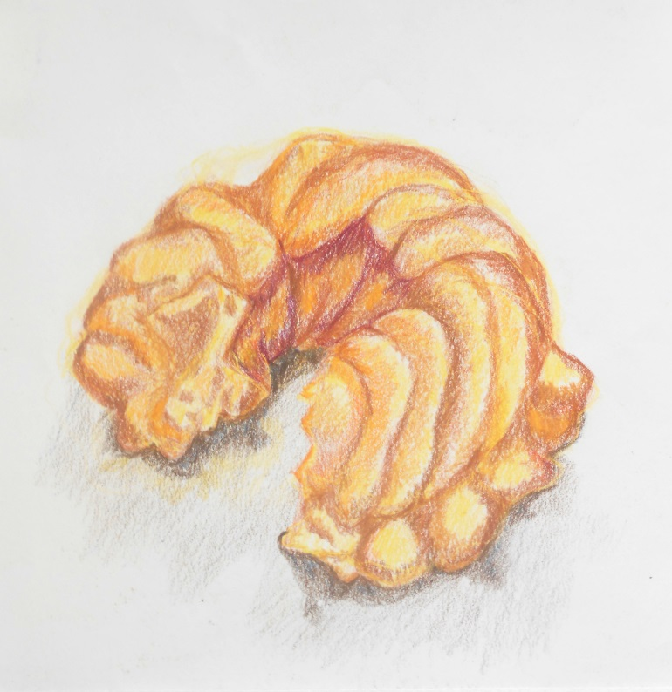
Drawing I Title: Breakfast Medium: Color pencil Size:8’in x18’in Objective: Show a progression of a object. The donut being eaten

Slide 11
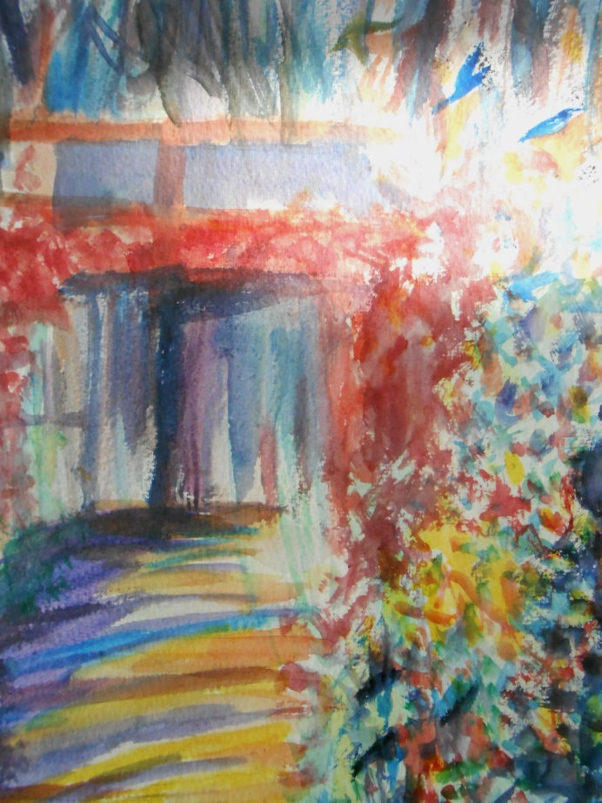
Drawing I Title: Monet Garden Medium: Watercolor Size:18’in x24’in Objective: Layering watercolor Landscape

Slide 12
Drawing II Title: MSBC Chris Matthew Medium: Mix Medium-Watercolor, Color Pencils, Pastels, Acrylic Paint Size:16’in x18’in “I drew Chris Matthew because of his face expression and neck wrinkles”

Slide 13
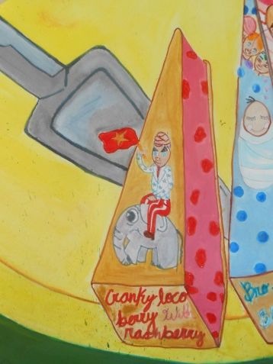
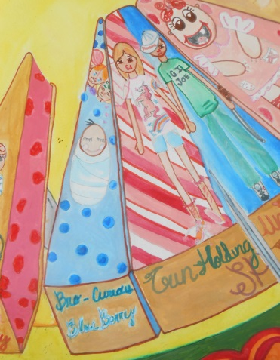
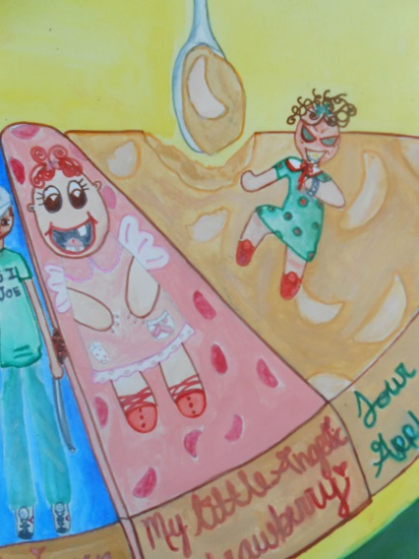
Drawing II Title: Melting Pot Medium: Mix medium-Markers, color pencils. Nail polish, Acrylic Paint, Water Color Size:16’in x18’in Objective: Editorial Magazine picture for a topic (Topic was Homosexuality in family, culture and genetics)

Slide 14
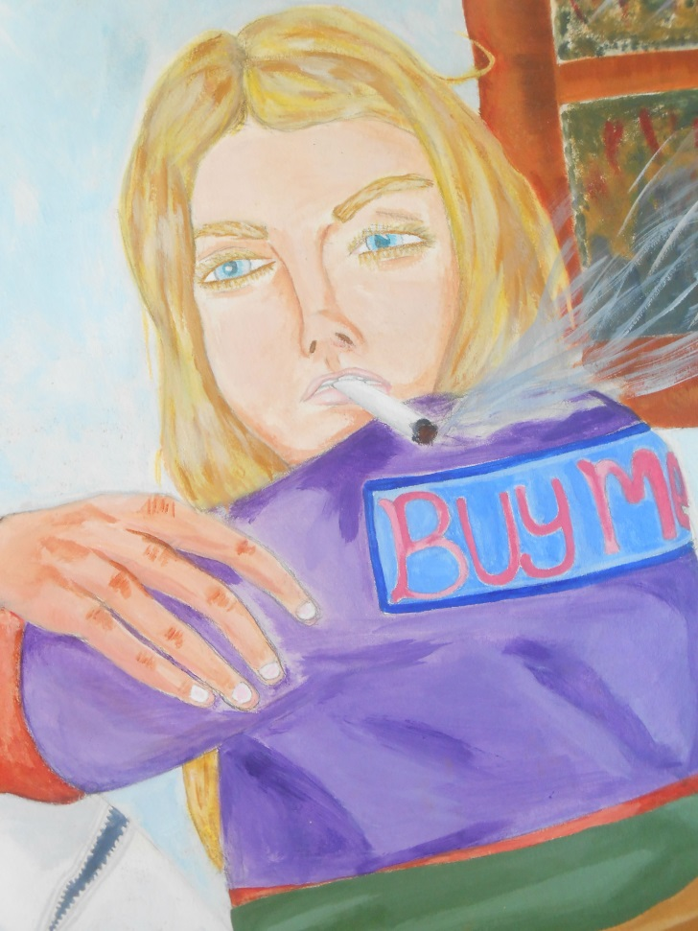
Drawing II Title: Buy Beauty-Buy death- Buy me Medium: Mix mediums-Acrylic Paint, color pencils, oil Pastels Size:18’in x24’in Objective: Narrative Painting

Slide 15
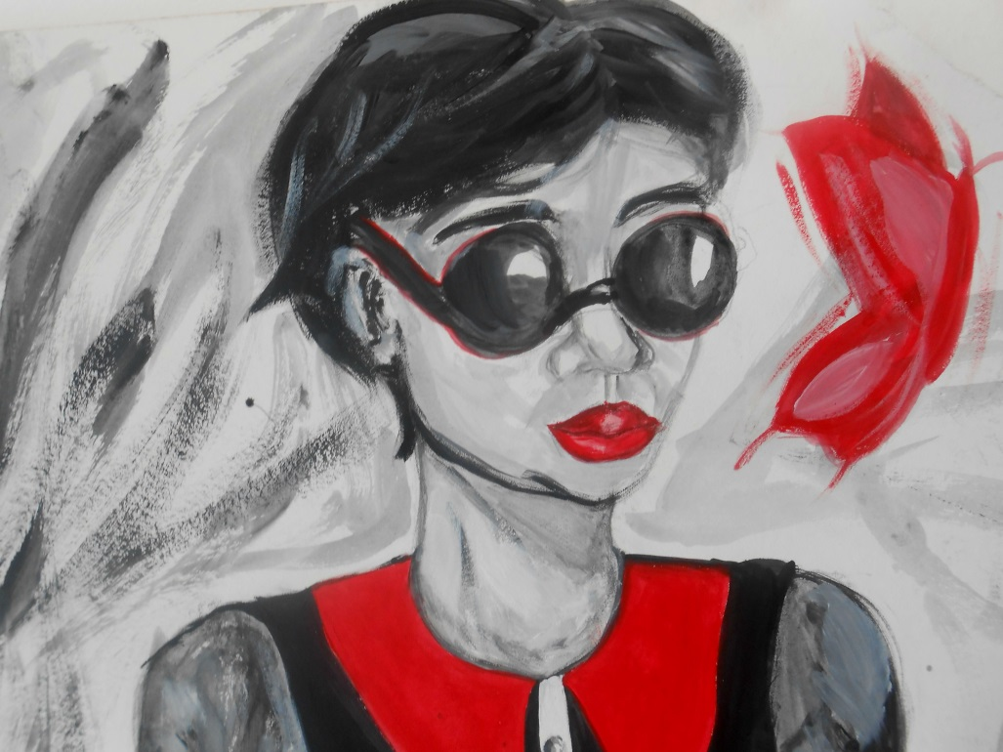
Drawing II Title: Cherry Noir Medium: Acrylic Paint Size:18’in x24’in Objective: Self Portrait Surrealism, Painterly Style (Quick brushstroke)

Slide 16
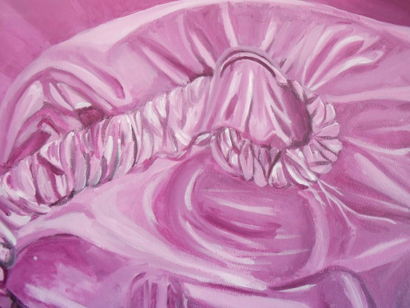
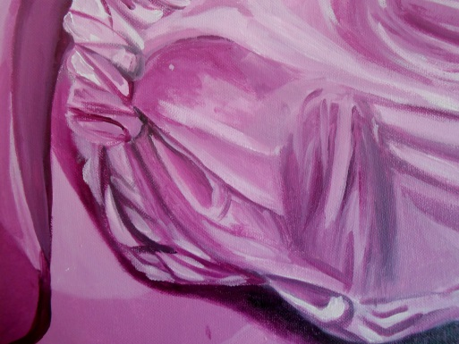
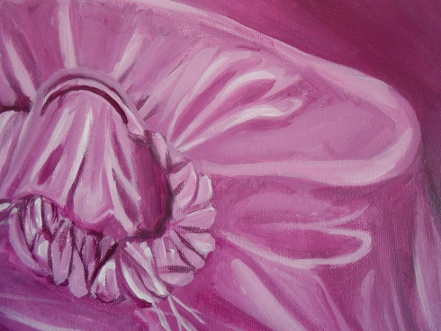
Painting I Title: Call 911! My phone’s choking me Medium: Acrylic Paint Size:16’in x24’in Objective: Monochromatic (Purple) still life Observation Painting

Slide 17
Painting I Title: Waking up with Chai and flowers Medium: Acrylic Paint Size:16’in x24’in Objective: Black and white still life Observation Painting

Slide 18
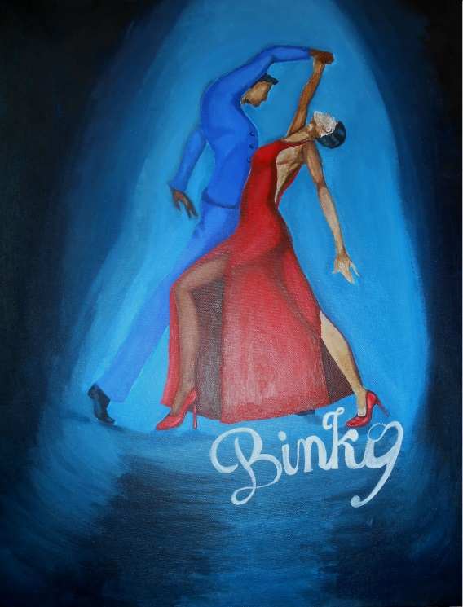
Painting II Title: Binky Wants to die Medium: Acrylic Paint Size:18’in x24’in Objective: Create a painting with a text that didn’t go along with it.

